Slide 1

Subsystems and commands
Authors:
Yoav Rozov, Tomy Tochilovsky
Source: https://docs.wpilib.org/en/stable/docs/software/commandbased/index.html
Notes:
Source: https://docs.wpilib.org/en/stable/docs/software/commandbased/index.html

Slide 2
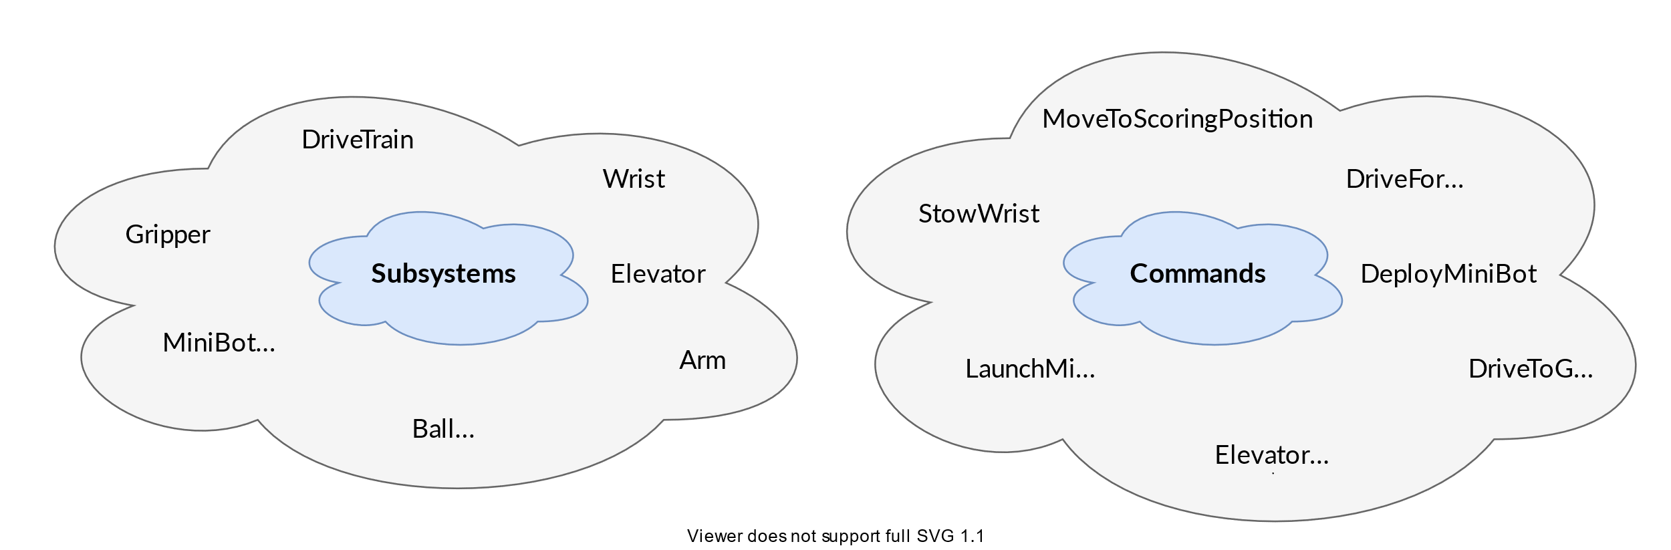

Definition
Subsystems: The basic building blocks of a robot’s functionality. They represent physical components of the robot (like drive trains, elevators, or intake mechanisms) and provide methods for controlling these components
Commands: Define a high-level actions that involve one or more subsystems. For example, a “DriveDistance” command might use a “DriveTrain” subsystem to drive a certain distance

Slide 3
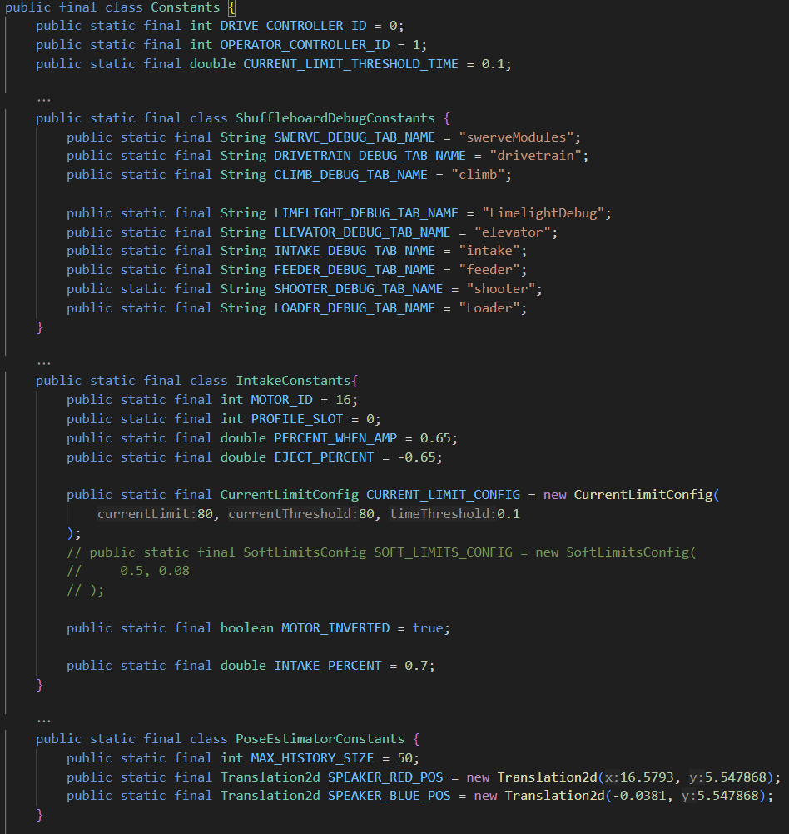
Constants
Constants: Constants.java is a file that contains the final “Constants” class
This class contains all the constant variables our robot code uses.
Notes:
*The 80A current limit is a joke

Slide 4
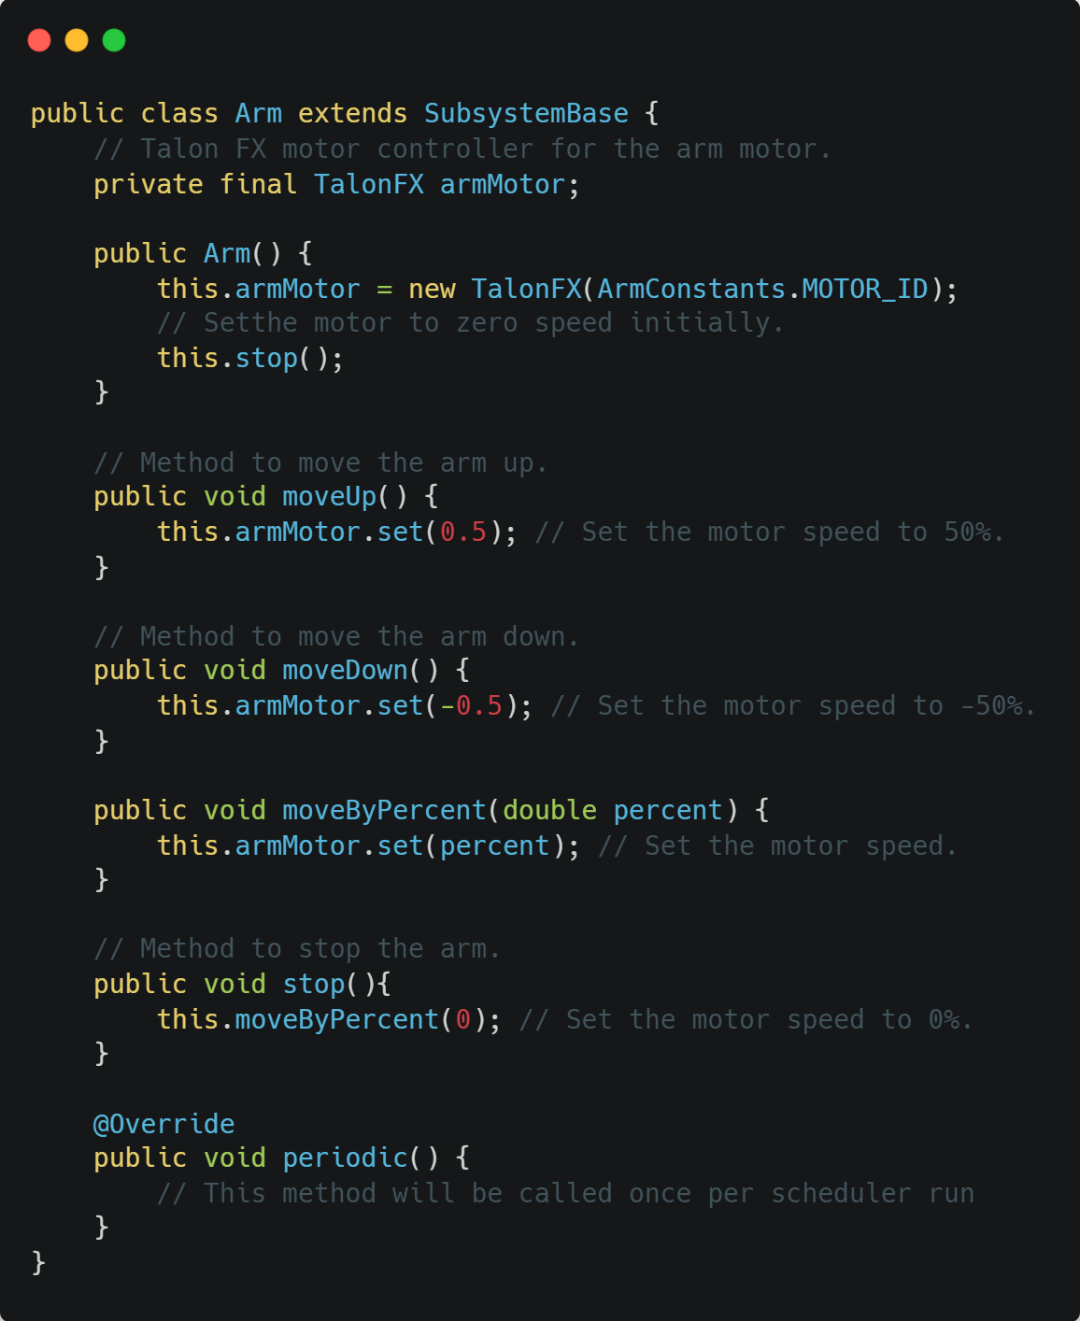
Subsystems - Example

Slide 5
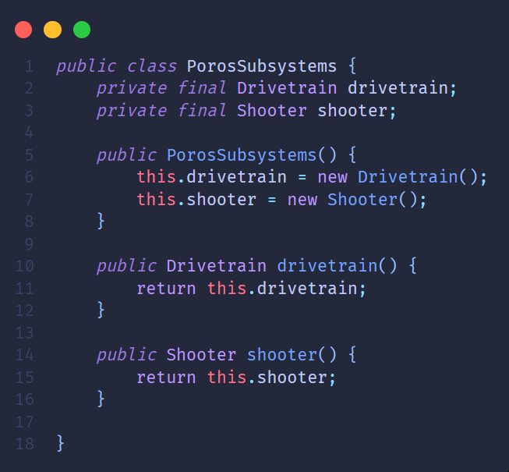
Subsystems – Example*
All subsystems need to be added as a variable to the PorosSubsystems* class. Initialized in the constructor and have a function that returns them.
*This is the convention we use, your team’s code might be different

Slide 6
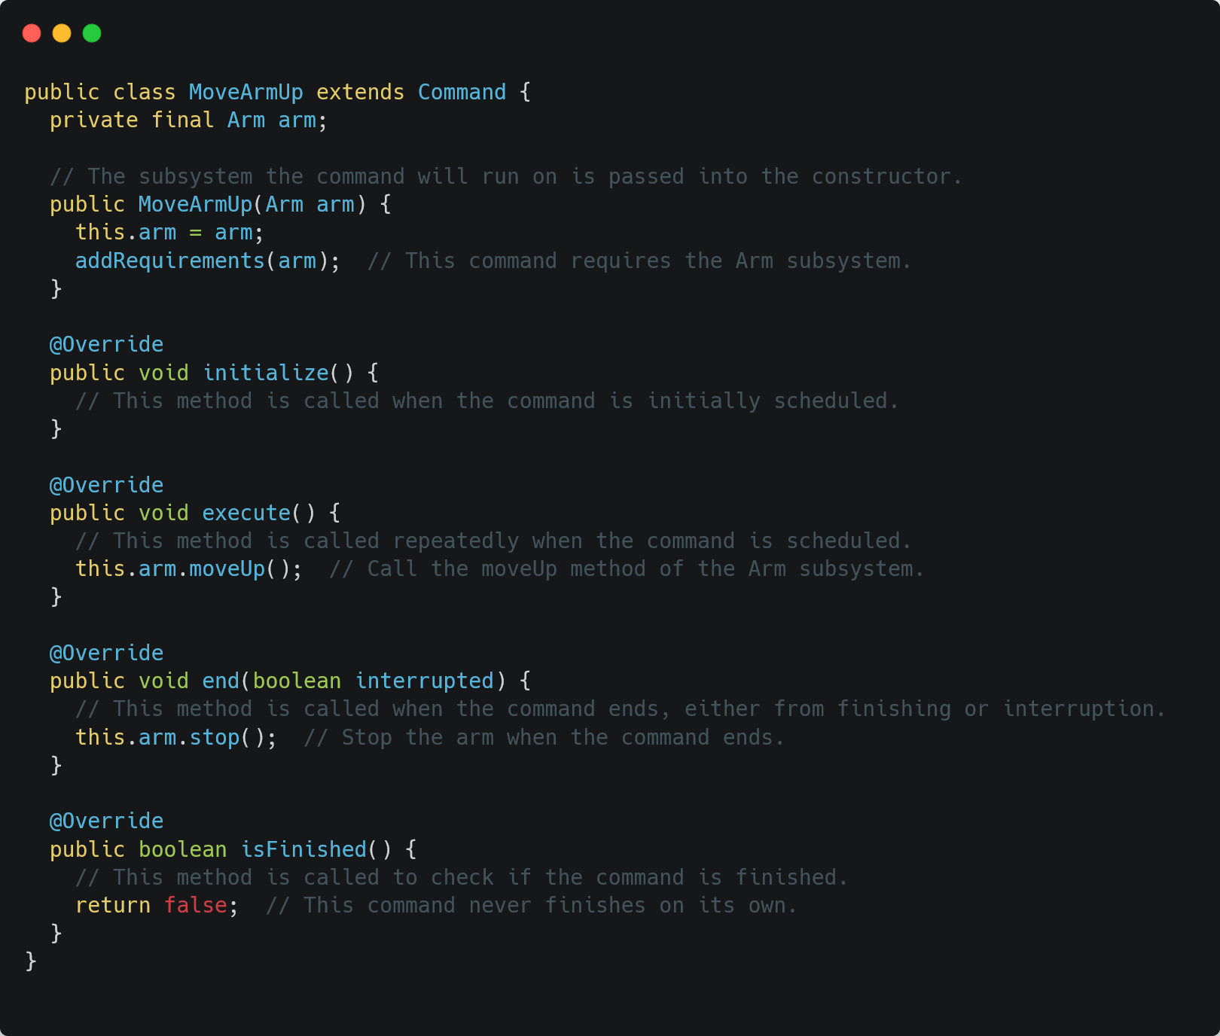
Command - Example

Slide 7
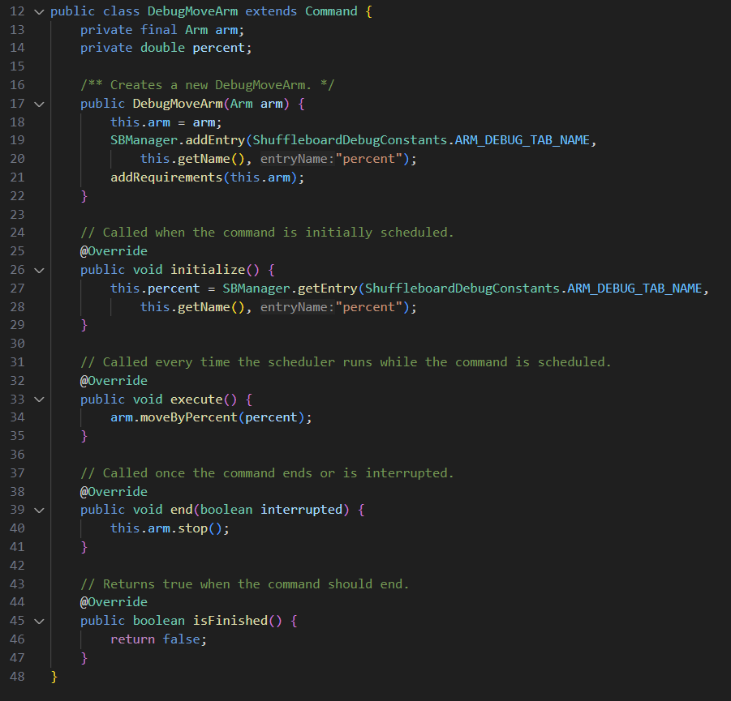
DebugCommand – Example*
What changed? Entry variable – The field in shuffleboard where we can pass parameters to the command.
DebugTab – The shuffleboard tab where the command would be.
Layout – The table of the command inside the tab. In order to get the parameter from the field we will call the SBManager.getEntry command (line 27).
*The SBManager is a helper class we created, you can view the source code here

Slide 8
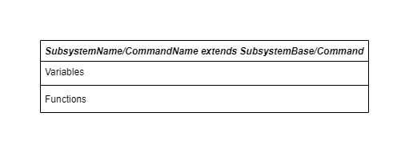
Command and Subsystem structure
All Subsystems and Commands are classes. So of course they will share the same structure as a class. Subsystems and Commands will all have class variables, constructors and functions.

Slide 9
Command scheduler
The Command Scheduler is the core of the command-based robot framework in WPILib. It is responsible for running commands and managing resource conflicts between them.
Running Commands - The command scheduler is responsible for running the command we write
Managing Resource Conflicts - If a new command is scheduled that requires a subsystem that’s already in use, the Command Scheduler will interrupt the currently running command so the new command can use the subsystem
Lifecycle Management - The Command Scheduler manages the lifecycle of each command. It calls the initialize() , execute() , isFinished() , and end() methods.
Notes:
The Command Scheduler is the core of the command-based robot framework in WPILib. It is responsible for running commands and managing resource conflicts between them.
Here’s a brief explanation of its main responsibilities:
Running Commands: The Command Scheduler runs commands, which are high-level actions that a robot can perform. Each command can specify which subsystems it requires, and the Command Scheduler ensures that each subsystem is only used by one command at a time.
Managing Resource Conflicts: If a new command is scheduled that requires a subsystem that’s already in use, the Command Scheduler will interrupt the currently running command so the new command can use the subsystem. This helps prevent conflicts where two commands are trying to use the same subsystem at the same time.
Lifecycle Management: The Command Scheduler manages the lifecycle of each command. It calls the initialize(), execute(), isFinished(), and end() methods at the appropriate times.
Periodic Running: The Command Scheduler has a run() method that should be called in the robot’s main loop. This method runs all scheduled commands and handles any resource conflicts.
In summary, the Command Scheduler is a crucial part of the command-based robot framework. It runs commands, manages resource conflicts, handles the lifecycle of commands, and should be called periodically in the robot’s main loop. It helps to structure the robot code in a modular, organized, and manageable way.

Slide 10
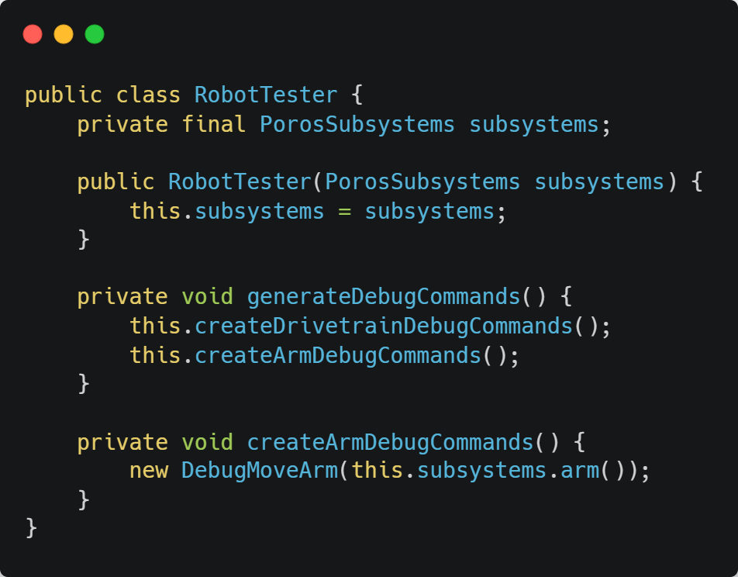
How to run our debug command
For each subsystem we will add a new function inside the RobotTester class, that will call all our debug commands
And we will call that function in the generateDebugTabs() function. It is important to note that we will be able to use these debug commands only while robot is enabled in Test mode.
Notes:
There are 2 main options to run a command:
Using the shuffleboard - Great for debugging and testing
With a controller - Used for driver’s control

Slide 11
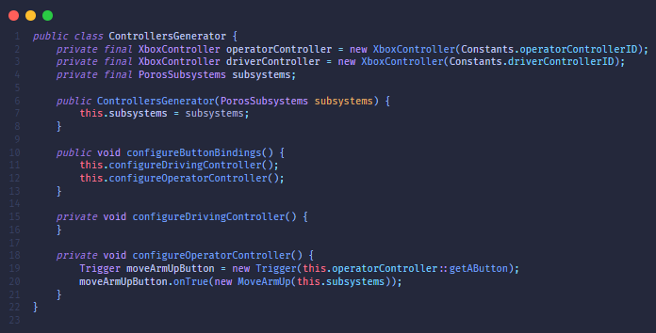
How to run our command with controller
Inside the ControllersGenerator class we will create a Trigger to the controller that we want to use (in this case it will be the operator controller using the A button). After we created a new Trigger we will set what action of the trigger activates what command. In the following example the action is onTrue (when A button is pressed) and the command is MoveArmUp.
*This is the convention we use, your team’s code might be different
Notes:
There are 2 main options to run a command:
Using the shuffleboard - Great for debugging and testing
With a controller - Used for driver’s control

Slide 12

Practice

Slide 13
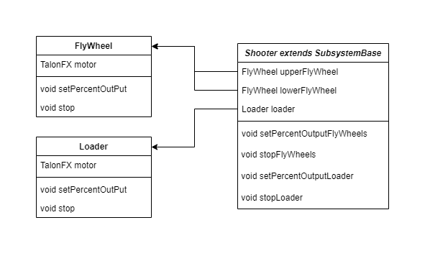
Create a subsystem for the shooter
Reminder! Class variables are either private or protected. Depending on the variable they might also be final.

Slide 14
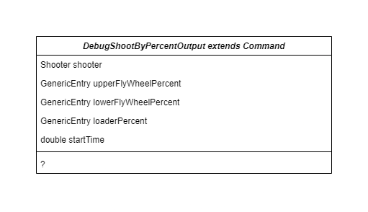
Create a command for the shooter
Write a debug command that will accelerate the flywheels and after 3 seconds activate the loader. Hint: use Timer class.

Slide 15
תודה על ההקשבה

